Slide 1
An Efficient Error Correction Approach
by using Successive Parity Generation
Supervised By
Prof. Dr. Muhammad Sheikh Sadi
Department of Computer Science and Engineering, KUET
Presented By
Md. Asaf-Uddowla Golap (1207005)
Shaikh Akib Shahriyar (1207011)

Slide 2
CONTENTS
Introduction
What is Coding
Memory Protection By Parity
Proposed Methodology
Successive Parity Generation (SPG)
Error Detection & Correction
Experimental Analysis
Conclusions

Slide 3
INTRODUCTION
Software and hardware are heavily linked in an intricately designed complex system.
Errors at hardware level are corrected through hardware module duplication techniques.
Different types of error correction codes are used.
A new coding approach for error correction against soft errors is proposed.

Slide 4
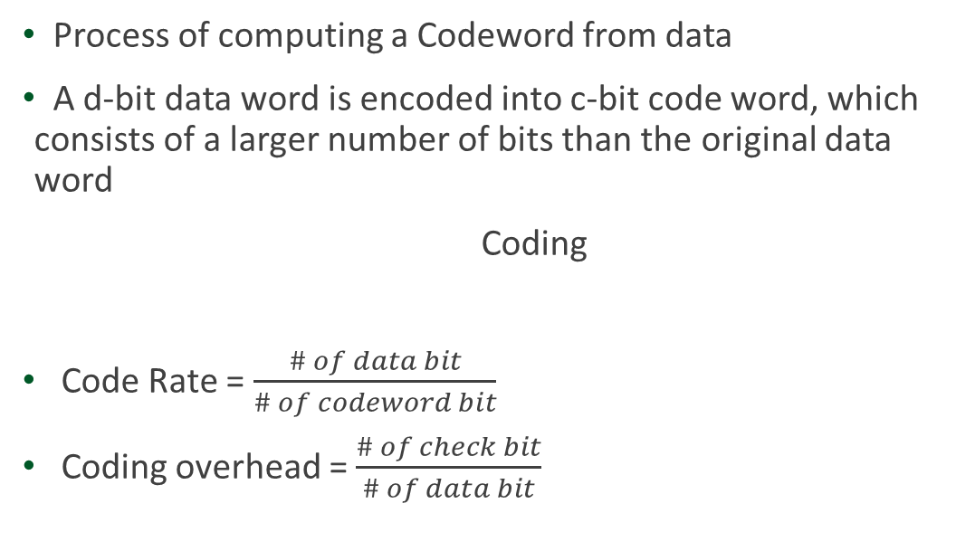
WHAT IS CODING
Process of computing a Codeword from data
A d-bit data word is encoded into c-bit code word, which consists of a larger number of bits than the original data word
Coding
Code Rate = $\frac{\# of data bit}{\# of codeword bit}$
Coding overhead = $\frac{\# of check bit}{\# of data bit}$
Data word
Check Bit
Codeword

Slide 5
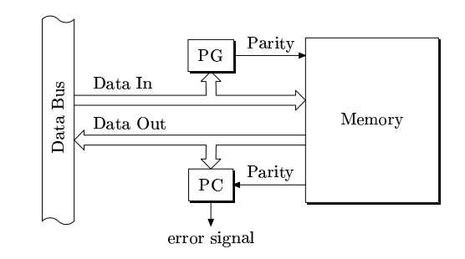
MEMORY PROTECTION BY PARITY

Slide 6
PROPOSED METHODOLOGY

Slide 7
METHODOLOGY OVERVIEW
Encoding
Error Detection & Correction

Slide 8
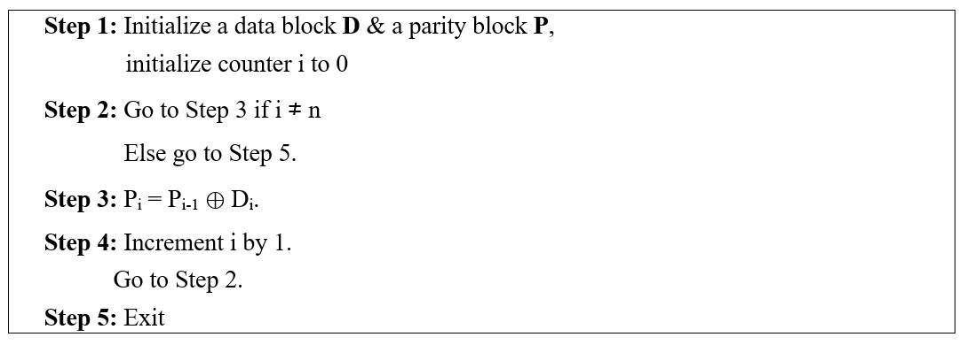
SUCCESSIVE PARITY GENERATION

Slide 9
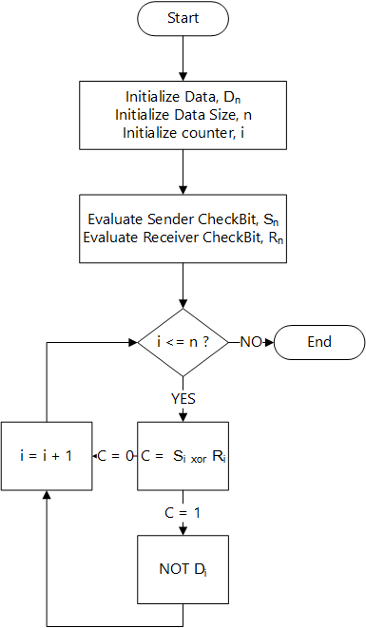
ERROR DETECTION & CORRECTION FLOWCHART

Slide 10
SUCCESSIVE PARITY GENERATION FORMULA
P₁ = P₀ ⊕ D₁ P₂ = P₁ ⊕ D₂ P₃ = P₂ ⊕ D₃ --------------------- P_{n} = P_{n − 1} ⊕ D_{n}

Slide 11
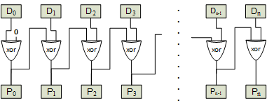
SUCCESSIVE PARITY GENERATION DIAGRAM

Slide 12
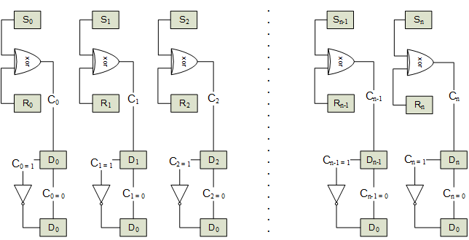
ERROR DETECTION & CORRECTION DIAGRAM

Slide 13
PARITY FOR CHECK BITS
P₀ = D₀ ⊕ D₈ ⊕ D₁₆ ⊕ D₂₄ ⊕ D₃₂ ⊕ D₄₀ ⊕ D₄₈ ⊕ D₅₆ P₁ = D₁ ⊕ D₉ ⊕ D₁₇ ⊕ D₂₅ ⊕ D₃₃ ⊕ D₄₁ ⊕ D₄₉ ⊕ D₅₇ P₂ = D₂ ⊕ D₁₀ ⊕ D₁₈ ⊕ D₂₆ ⊕ D₃₄ ⊕ D₄₂ ⊕ D₅₀ ⊕ D₅₈ P₃ = D₃ ⊕ D₁₁ ⊕ D₁₉ ⊕ D₂₇ ⊕ D₃₅ ⊕ D₄₃ ⊕ D₅₁ ⊕ D₅₉ P₄ = D₄ ⊕ D₁₂ ⊕ D₂₀ ⊕ D₂₈ ⊕ D₃₆ ⊕ D₄₄ ⊕ D₅₂ ⊕ D₆₀ P₅ = D₅ ⊕ D₁₃ ⊕ D₂₁ ⊕ D₂₉ ⊕ D₃₇ ⊕ D₄₅ ⊕ D₅₃ ⊕ D₆₁ P₆ = D₆ ⊕ D₁₄ ⊕ D₂₂ ⊕ D₃₀ ⊕ D₃₈ ⊕ D₄₆ ⊕ D₅₄ ⊕ D₆₂ P₇ = D₇ ⊕ D₁₅ ⊕ D₂₃ ⊕ D₃₁ ⊕ D₃₉ ⊕ D₄₇ ⊕ D₅₅ ⊕ D₆₃

Slide 14
EXAMPLE(1/4)
Dataword
Check bit
Codeword
Error in Dataword
Dataword After Error
Checkbit After Error

Slide 15
EXAMPLE(2/4)
Dataword
Partially Corrected Dataword
New Checkbit

Slide 16
EXAMPLE(3/4)
Dataword
Partially Corrected Dataword
New Checkbit

Slide 17
EXAMPLE(4/4)
Dataword
Partially Corrected Dataword
New Checkbit

Slide 18
EXPERIMENTAL ANALYSIS

Slide 19
COMPARISON OF OVERHEAD AND CODE RATE

Slide 20
CORRECTION RATE
Correction Rate Falls

Slide 21
OVERHEAD VS DATAWORD SIZE
20 Mb
16 Mb

Slide 22
CORRECTION RATE OVER DIFFERENT BIT

Slide 23
TIME COMPARISON

Slide 24
CONCLUSION
Focused on correction rate.
The proposed successive method has been implemented for 64 bit of data.
Works for any dataword size.
To reduce system overhead, some bit compression techniques for check bits can be implemented.

Slide 25
REFERENCES(1/2)
Costas Argyrides, Dhira j K. Pradhan, and Taskin Ko cak, ”Matrix Codes for Reliable and Cost Efficient Memory Chips,” IEEE Transaction on Very Large Scale Integration (VLSI) Systems, VOL. 19, NO. 3, Mar. 2011.
Jing Guo, Liyi Xiao, Zhigang Mao and Qiang Zhao, ”Enhanced Memory Reliability Against Multiple Cell Upsets Using Decimal Matrix Code,” IEEE Transaction on Very Large Scale Integration (VLSI) Systems, Vol: 22, Issue: 1, pp. 1-9, Jan. 2014.
Md. Shamimur Rahman, Muhammad Sheikh Sadi and Sakib Ahammed ,Jan Jurjens, ”Soft error tolerance using Horizontal-Vertical-Double-Bit Diagonal parity method,” in 2nd International Conference on Electrical Engineering and Information and Communication Technology (ICEEICT) 2015 Iahangirnagar University, Dhaka-I 342, Bangladesh , 21-23 May 2015.

Slide 26
REFERENCES(2/2)
Md. Shamimur Rahman, Sakib Ahammed (2015). ”Soft Error Tolerance using HVDQ:Horizontal- Vertical-Diagonal-Queen Parity Method,” (Undergraduate Thesis). Retrieved from Rental Library, Dept. of CSE, KUET. (Accession No. CSER-15-01).
Koren, I. and Krishna, C. 2009. ”Fault Tolerant Systems”. 1st ed. Morgan Kaufmann Publishers. p. 55-74
P. Vijayakumar, Shalini Sharma ”An HVD based error detection and correction of soft errors in semiconductor memories used for space applications,” IEEE International Conference on Devices, Circuits and Systems (ICDCS), pp. 563 - 567,15-16 Mar. 2012.
M. Kishani H.R. Zarandi H. Pedram A. Tajary M. Raji B. Ghavami, ”HVD:Horizontal-vertical-diagonal error detecting and correcting code to protect against with soft errors,” Automation for Embedded Systems, vol. 15, no. 3-4, pp. 289-310, Dec. 2011.

Slide 27
Thank you ☺
Any question ?

Slide 28
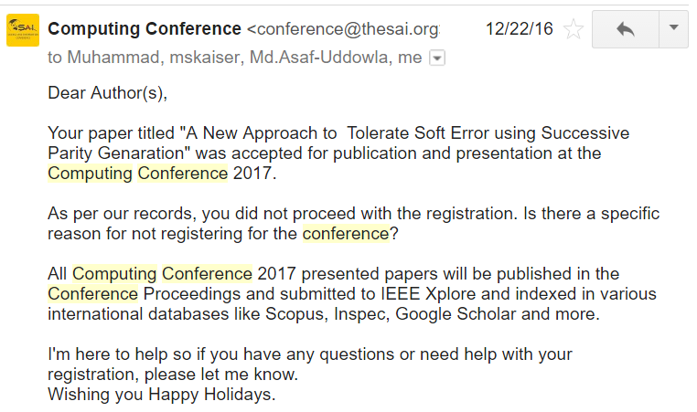

Publication
The proposed methodology was accepted for publication in “Computing Conference, 2017” in London, organized by IEEE.

